Slide 1
National Energy Technology Laboratory (NETL) Site Operations Support (SOS) Services – SOS5
Town Hall Meeting

Slide 2
Agenda
Safety Minute
Our People Approach
Our Team
Contract Approach
Transition
Communication
Questions

Slide 3
Safety Minute – Distractions On The Job
80% of accidents can be attributed to the actions of the individuals involved.
Unsafe behavior causes 4X as many accidents and injuries compared to unsafe conditions.
A significant portion of accidents and injuries occur due to distractions while working.
Distraction | Mitigation
Mental Distraction | Focus on the task at hand
Inattention | Stay focused and pay attention to warnings and alarms
Machinery | Arrange your workstation in a well-lit, unobstructed area away from busy foot traffic to prevent distractions
Shortcuts | Prioritize safety over expediency to minimize the risk of injuries for yourself and your co-workers
Overconfidence | Ensure you have complete instructions before initiating a task and seek clarification on work procedures and safety measures
Poor Housekeeping | Maintaining a clean and organized workspace sets a safety standard for others to follow for both safety and a sense of pride
Ignoring Safety Procedures | Always adhere to safety guidelines and think through tasks to ensure safety

Slide 4
Our Values + People
People are our principal resource and our approach to their well being is embodied in our values. These values guide how we work, lead, and deliver. All transferees will be treated fairly and in accordance with our values.
LOVE We lead with love —authentic and freely given. Showing care makes us stronger. It’s how we build peace and trust in our teams.
RESPECT We treat every person with respect. Appreciation, fairness, and kindness shape how we work together.
BRAVERY We do the right thing, especially when it’s hard. Bravery means acting with integrity, not comfort.
TRUTH We ground ourselves in truth. Our decisions are guided by personal clarity and understanding our why.
HONESTY We speak openly and act transparently. Honesty strengthens integrity and builds lasting trust.
HUMILITY We know we’re part of something bigger. We stay grounded, treat others as equals, and honor all life.
WISDOM We listen, reflect, and grow. We carry forward the insights of our mentors, leaders, and lived experiences.

Slide 5



SOS5 Team
Prime Contractor
Subcontractors


Slide 6
Waseyabek Federal Services, LLC
Waséyabek Federal Services, LLC (WFS) is a 100% Tribally-owned entity organized in the State of Michigan
Owned by the Nottawaseppi Huron Band of the Potawatomi (NHBP), a Tribe re-recognized by the US Federal government in 1995
Parent company Waséyabek was formed to pursue non-gaming, economic diversification opportunities on behalf of the Tribe
WFS is an 8(a) subsidiary of Waséyabek and the prime contractor for Site Operations Support (SOS5) Services
WFS is currently holds contracts with DOE at Savannah River Site and Fermi National Laboratory and additional contracts supporting GSA, Navy, BAE Systems, HUD, USDA, and FDIC

Slide 7
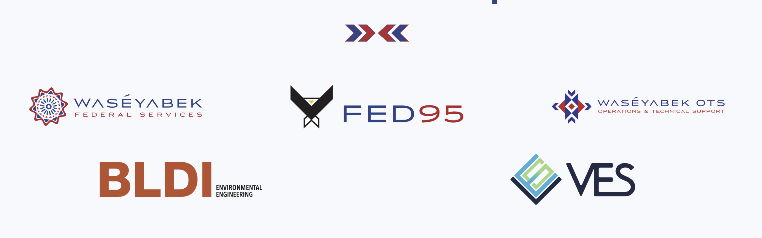
Waséyabek Federal Group
WFS is an 8(a) subsidiary of Waséyabek and part of the Waséyabek Federal Group

Slide 8
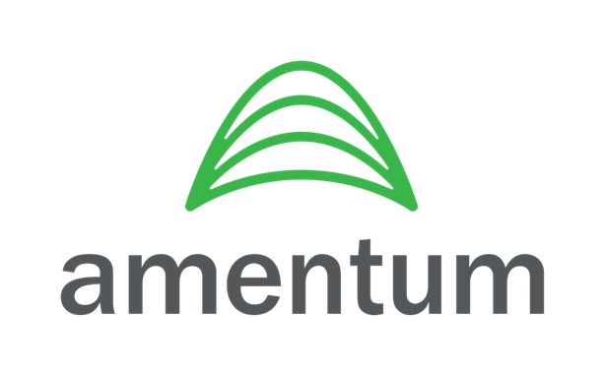
Amentum - A global leader in advanced engineering and innovative technology solutions. Commitments underpinned by belief that safety, collaboration and well-being are integral to success.
Headquartered in Chantilly, Virginia - More than 53,000 employees in approximately 80 countries across all 7 continents.
Trusted partner with DOE Laboratories providing Management & Operation of Idaho National Laboratory, Lawrence Livermore National Laboratory, and Fermi National Accelerator Laboratory.
Amentum and its legacy companies have supported NETL across multiple programs for over 45 years.
Industry and DOE complex leader in | Nationally recognized credentials in
Project Management Facility Operations Conduct of Operations Corporate Reachback | Integrated Safety Management Systems Industrial and Nuclear Safety

Slide 9
E2 Consulting Engineers, Inc.
Founded in 1988 with over 800 current employees nationwide and abroad
Headquartered in Denver, CO with 11 satellite offices across the U.S.
Specialize in:
Facilities Support Services
PMO & Project Controls
Environmental Services
Engineering & Design
IT / Technology Services
Construction Management & Inspection Services
Professional & Non-Professional Staff Augmentation
Continuous support of NETL SOS contracts since 2015

Slide 10
Our Contract Approach
Safety First
People
Environment
Equipment
Smooth, Seamless Transition
Single, Fully Integrated Team – One Line of Authority
Priority Focus is on the R&D Mission
Frequent, Transparent Communication
Disciplined Work Execution w/ Flexibility
Service Organization Mentality
Reach-back to Depth and Breadth of our Three Companies

Slide 11
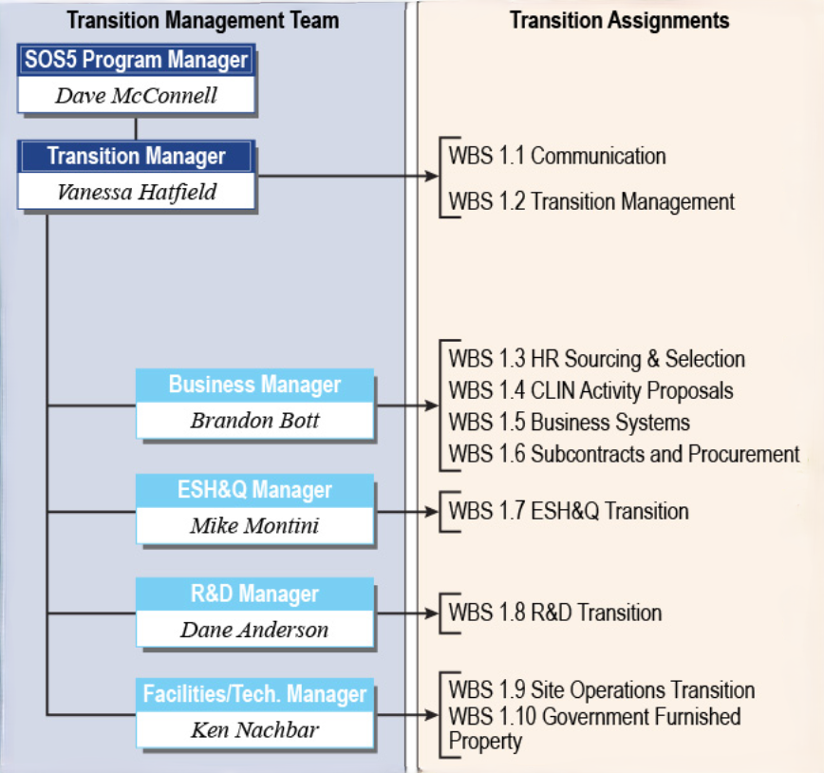
Transition Team

Slide 12
Transition Key Points
WFS has posted positions for the Amentum Engineering and E2 UMWA individuals who will be hired by WFS and will have offer letters and packages out late July/early August
E2 will post any remaining Pittsburgh Supervisor positions and will have offer letters and packages out late July/early August
HR representatives are available to review benefits/answer questions
We will execute a smooth contract transition that minimizes disruption and will not compromise the ongoing operations.
We will provide contract transition updates to you through our WFS Website (Dave’s Desk memos, etc.).

Slide 13
Communication
Human Resource Team
Waséyabek - Holly Benesch –hbenesch@waseyabek.com
Waséyabek - Caitlin Fisher –cfisher@waseyabek.com
Amentum - Kimbly Davis Williams –Kimbly.williams@Amentum.com
E2 - Kimberley Meyers –kimberley.meyers@e2.com
E2 - Valerie Whetzel valerie.whetzel@e2.com
Transition Interface
Vanessa Hatfield vhatfield@wfedservices.com
Website for Dave’s Desk and Other NETL SOS5 transitions related information
www.wfedservices.com

Slide 14
WE WON!!!!

